Slide 1



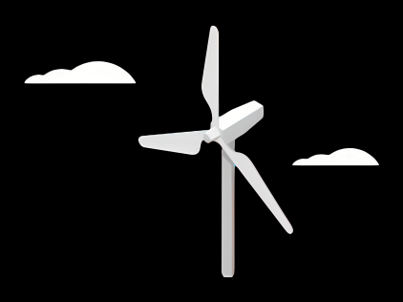
Report: Lidar Assisted Controller
Date: 05/10/2025
Supervisor: Prof. David Schlipf
Group members: Annika Gathje, Hesham Mahmoud, Midhun Kanichattu Venu

Slide 2
New functions in the simulator OpenFAST
Envolving turbulence
→ previous assumption: Taylor‘s frozen turbulence (wind remains constant during transport)
→ new: integration of evoTurb (stochastic wind field)
→ wind development reduces correlation between measured and actual wind speed
→ realistic prediction of Lidar data
Blade blockage effect = Lidar beams can be blocked by rotor blades
→ algorithm detects blockage through geometric modelling of the leaves
→ important for signal availability and data processing
Adjustable data availability = Lidar data is dependent on CNR (carrier to noise ratio)
→ modelling via spectral analysis: realistic simulation of data gaps

Slide 3
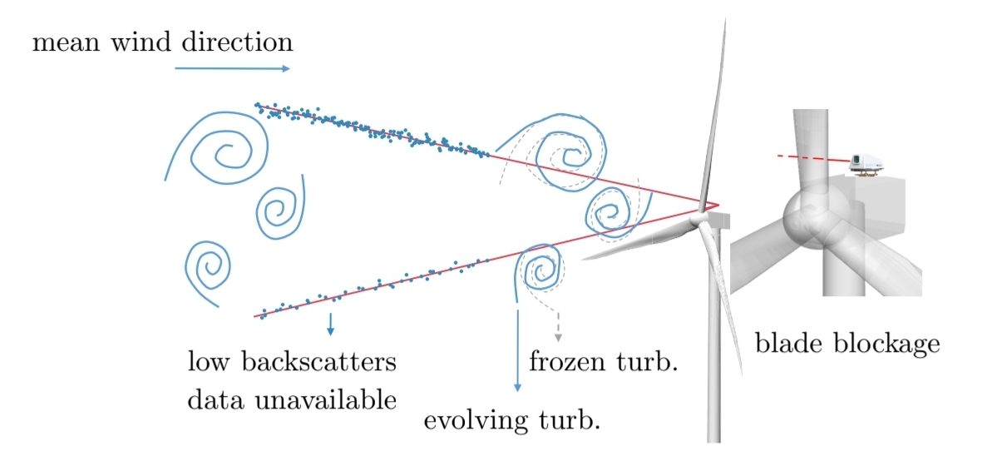
Frozen turbulence
8

Slide 4
New functions in the simulator OpenFAST
Envolving turbulence = integration of evoTurb (stochastic wind field)
→ wind development reduces correlation between measured and actual wind speed
→ realistic prediction of Lidar data
Blade blockage effect = Lidar beams can be blocked by rotor blades
→ algorithm detects blockage through geometric modelling of the leaves
→ important for signal availability and data processing
Adjustable data availability = Lidar data is dependent on CNR (carrier to noise ratio)
→ modelling via spectral analysis: realistic simulation of data gaps

Slide 5
Method and Implementation
EvoTurb integration
→ simulate wind fields for rotor and Lidar separately
Blade blockage detection
→ simplified geometry and Ray Triangle interaction algorithm
CNR modelling
→ empirical spectrum and white noise comparison

Slide 6
Setup & Tuning (OpenFAST v3.0 • ROSCO v2.6 • IEA 3.4 MW)
 | Feedback(baseline) | FF(feedforward)
DLL_FileName | ROSCO.DLL | WRAPPER.dll
DLL_InFile | IEA-3.4-130 RWT_DISCON.IN | WRAPPER.IN
ProcName | DISCON | DISCON
FFP tuning: LPF=0.5 rad/s, buffer=3 s, curve ↓ • KPIs: t>12 s, GenSpeed std & Pitch-rate std).

Slide 7
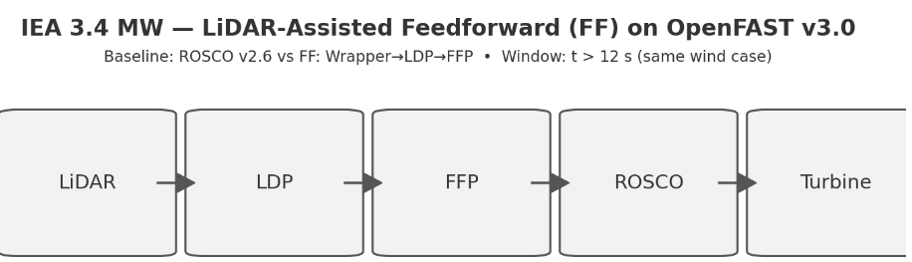
IEA 3.4 MW — LiDAR-Assisted Feedforward (FF) on OpenFAST v3.0

Slide 8
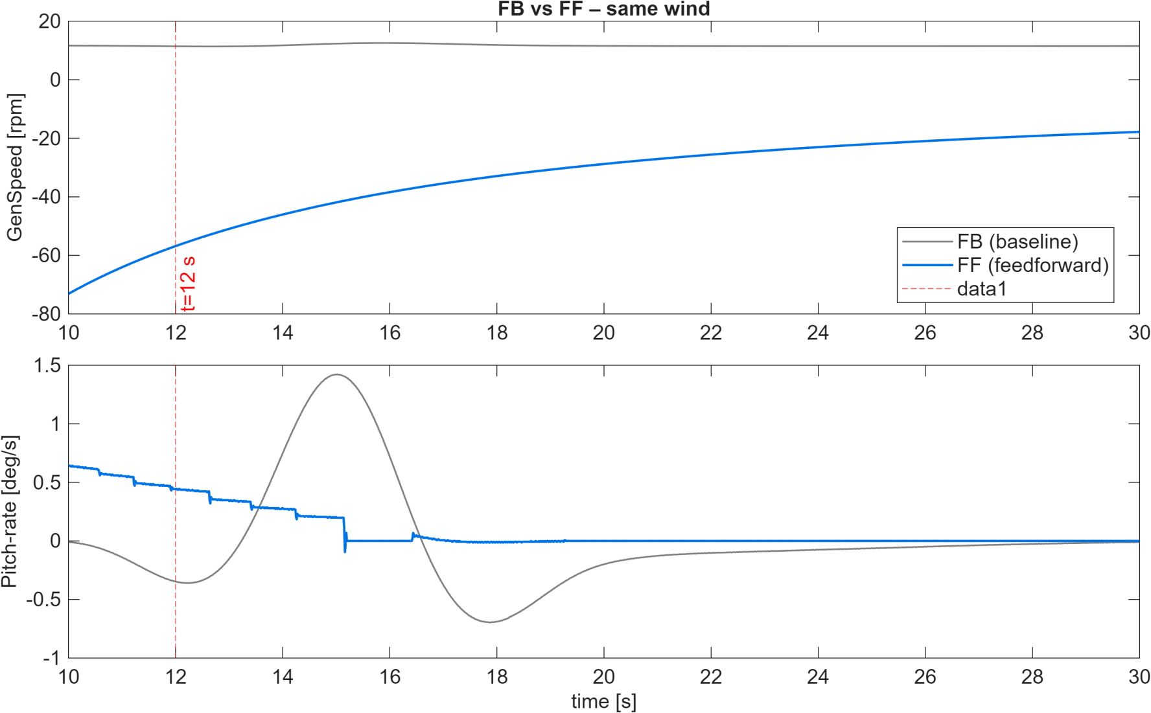
Results: FB vs FF (Same Wind, t = 10–30 s)
FB vs FF same wind (t=10–30 s), KPIs on t>12 s: GenSpeed std & Pitch-rate std.

Slide 9
Conclusion and Outlook
Realistic Lidar simulation is crucial for controller development
The three new features significantly improve model fidelity
→ Indispensable for interpreting data correctly
Adaptation to local atmospheric conditions necessary
controller must be able to deal with data gaps e.g. buffer storage, interpolation, adaptive control strategies
- position and orientation of the control system must be strategically chosen to minimise blockage

Slide 10
Reference
[1] Matthew L Aitken, Michael E Rhodes, and Julie K Lundquist.
Performance of a wind-profiling lidar in the region of wind turbine rotor disks.
Journal of Atmospheric and Oceanic Technology, 29(3):347–355, 2012.
[2]Matthieu Boquet, Philippe Royer, Jean-Pierre Cariou, Mehdi Machta, and Matthieu Valla.
Simulation of doppler lidar measurement range and data availability.
Journal of Atmospheric and Oceanic Technology, 33(5):977–987, 2016
[3]David Schlipf. Lidar-Assisted Control Concepts for Wind Turbines.
Dissertation, University of Stuttgart, 2015.
[4] David Schlipf, Feng Guo, and Steffen Raach. Lidar-based estimation of turbulence
intensity for controller scheduling. Journal of Physics: Conference Series, 1618:032053, sep 2020.
[5] David Schlipf, Steffen Raach, and Florian Haizmann. Control system for controlling a turbine,
method for controlling a turbine, and wind turbine, Patent EP3717770B1, 2018

